Slide 1
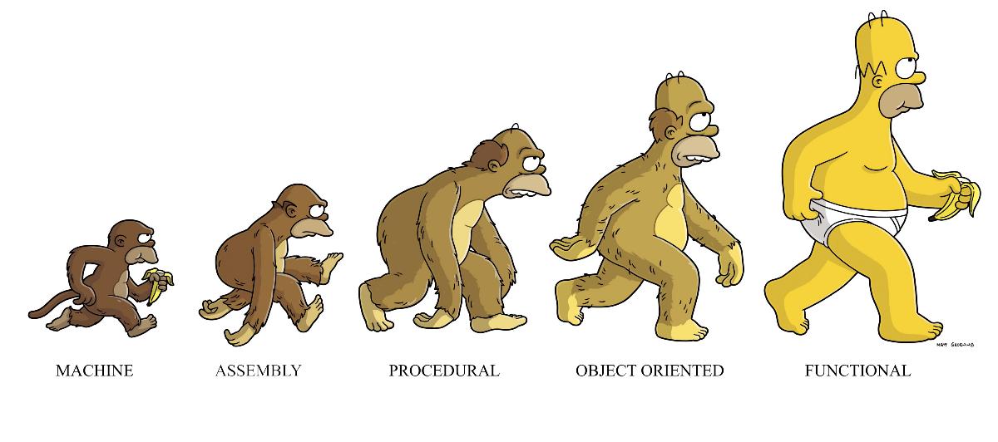
EVOLUTION OF PROGRAMMING LANGUAGES

Slide 2
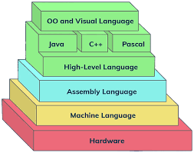
Programming Languages

Slide 3
Objectives
State what are programming Languages
State the different types of programming languages
Describe what is low level language
State the two type of Low level languages
Outline the differences between machine code and assembly language
Describe the structure of the assembly language
Explain the instruction set of assembly language

Slide 4
Review Questions
What is a programming language?
What is high level language?
What is low level language?
List the different generations of programming languages
Give the two types of programming language
What is the difference between assembly and machine code
List the different generations of programming language

Slide 5
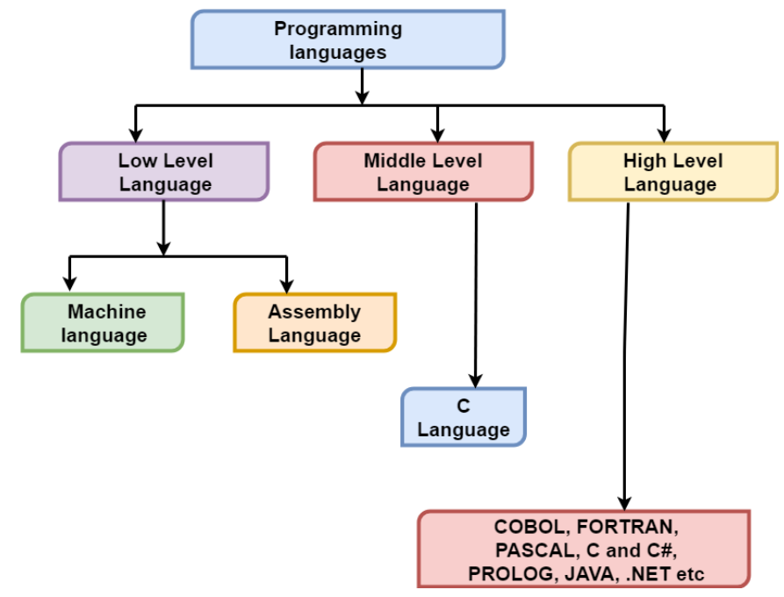
Programming Languages
Types of Programming Languages
Low level programming language. (LLL)
High level programming language (HLL).

Slide 6
Low Level Language

Slide 7
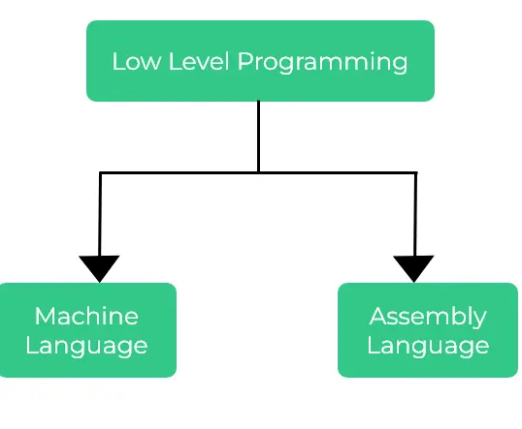
Low level language
Is often known as a computer's native language and is very close to writing actual machine instructions.
It relate to the specific architecture and hardware of a particular type of computer.
It works to control a computer's operational semantics and provides little or no abstraction (hiding complexity and unnecessary details from the users) of programming ideas
Types

Slide 8
Machine Code
Machine Language is fundamentally the only language which a computer can understand.
A computer can understand only one language which is the machine code, and it is represented inside the computer in a form of binary digits 0 and 1
Instructions in machine code comprise of a certain number of bits. If instructions for a particular processor are 8 bits, for example, the first 4 bits part (the opcode) tells the computer what to do and the second 4 bits (the operand) tells the computer what data to use.

Slide 9
Machine Code
Advantages
Machine language makes fast and efficient use of the computer.
Efficient use of storage for instructions and data
It requires no translator to translate the code. It is directly understood by the computer.
Disadvantages
It is machine dependent
Take a long time to write codes in binary form
Computer storage location must be addressed directly
It requires high level of programming skills

Slide 10
Assembly Language

Slide 11
Assembly Language
A low level language that provides a human-readable representation of machine code instructions, which are directly executed by the computer's processor.
Assembly language is a specific to the architecture of a particular computer or processor.
It is considered a bridge between machine code and higher-level programming languages.

Slide 12
Features of Assembly Language
Instructions are written using mnemonics.
Each mnemonic corresponds to a specific machine code instruction that the processor can directly execute.
allows for specifying memory addresses and data manipulation.
often used in areas where performance is crucial, such as operating systems, device drivers, embedded systems, and real-time systems.
Each computer architecture has its own assembly language.

Slide 13
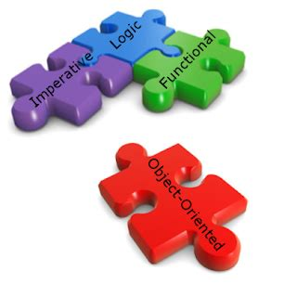
Structure of the Assembly Language
The structure of assembly language and machine code instructions is the same.
Each instruction has an
opcode that identifies the operation to be carried out by the CPU.
an operand that identifies the data to be used by the opcode.

Slide 14

Opcode
The opcode (operation code) is a part of the assembly language instruction that specifies the operation to be performed.
It's a mnemonic representation of an underlying machine code instruction, making it easier for humans to read and write. Example MOV, ADD, SUB, JMP

Slide 15
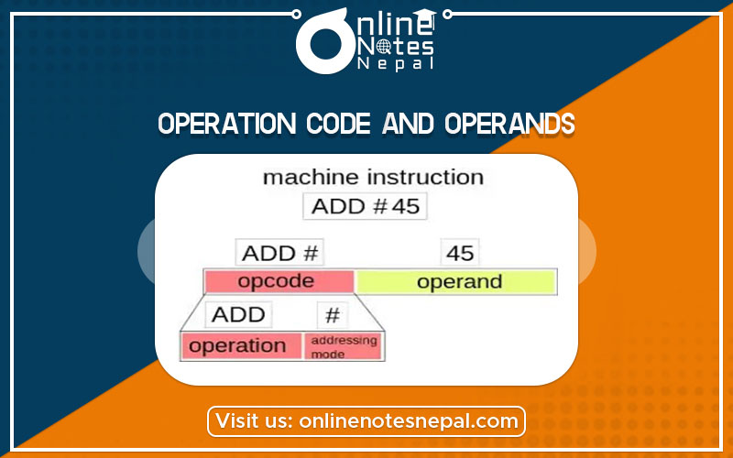
The operand
The operand(s) of an assembly instruction specify the data or memory address to be operated on or the data locations.
Operands can be registers, immediate values, memory addresses, or labels

Slide 16

Assembly Language instruction set.
An instruction set, often abbreviated as ISA (Instruction Set Architecture), is a collection of instructions that a processor can execute.
It includes a variety of instructions that specify different operations, such as arithmetic and logical operations, data movement, control flow, and input/output operations.

Slide 17
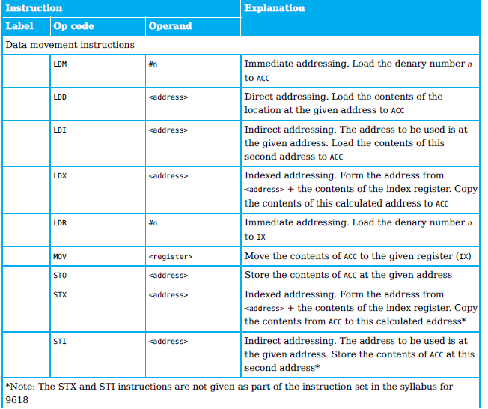
Data Movement Instruction)

Slide 18
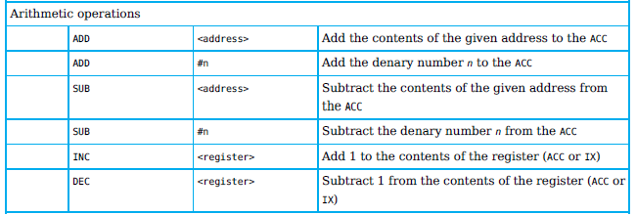
Arithmetic Operation

Slide 19
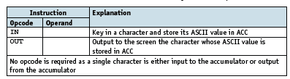
Input and output of data instructions
These instructions allow data to be read from the keyboard or output to the screen.

Slide 20
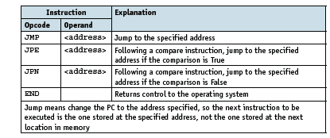
Unconditional and conditional instructions

Slide 21

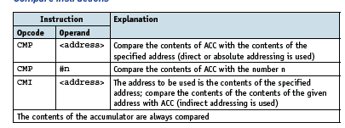
Compare instructions

Slide 22
Addressing modes
Addressing modes in assembly language are
the ways in which operands are specified in instructions.
Allow programmers to manipulate data efficiently and express complex operations.
The specific set of addressing modes available depends on the architecture and instruction set of the processor.

Slide 23
Direct /Absolute addressing
The operand's memory address is directly specified in the instruction.
For instance, MOV AX, [2000H] means the value at memory address 2000H is moved into the AX register.

Slide 24
Indexed addressing
the contents of the memory location found by adding the contents of the index register (IR) to the address of the memory location in the operand are used.

Slide 25
Indirect addressing
the contents of the contents of the memory location in the operand are used.
The memory address of the operand is specified indirectly through a register or a memory location.
Example, in the instruction LOAD R1, [R2], the value in the memory location pointed to by the content of register R2 is loaded into register R1.

Slide 26
Immediate addressing
the value of the operand only is used.
The operand is a constant value directly specified in the instruction.
Example, MOV AX, 10 loads the value 10 directly into the AX register

Slide 27
Relative addressing
The memory address used is the current memory address added to the operand.

Slide 28
Symbolic addressing
Only used in assembly language programming. A label is used instead of a value.
allows programmers to use meaningful labels or symbols to represent memory addresses or jump targets instead of specifying the actual memory addresses directly.

